Slide 1
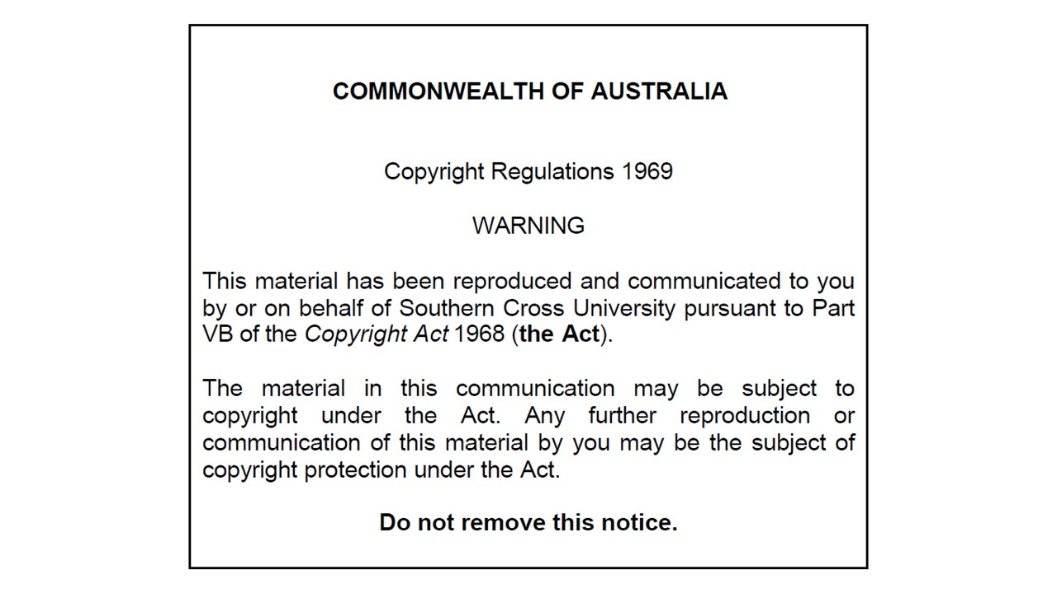

Slide 2
First Part/Chapter of the Autonomic Nervous System (ANS) Pharmacology
Introductory Pharmacology PHAR2001
Dr Ken Wojcikowski

Slide 3
Autonomic Nervous System Pharmacology
Chapter Approach for the ANS:
  Introduction
  Adrenergic pharmacology (Agonists)
  Adrenergic pharmacology (Antagonists)
  Cholinergic pharmacology

Slide 4
Autonomic Nervous System Pharmacology
Foundational Information for Understanding Autonomic Nervous System (ANS) Pharmacology
Lesson 1:
Overview of the autonomic nervous system
Introductory Pharmacology PHAR2001
Dr Ken Wojcikowski

Slide 5
Objectives for first ANS chapter
Describe the general properties of the ANS including the bodily functions it helps regulate, its two neuron nature, the neurotransmitters used, and the enzymes that degrade those neurotransmitters in the synaptic cleft.
Give the other names of a sympathomimetic drug (for instance, adrenergic agonist), a sympatholytic drug (for instance, an adrenergic antagonist or blocker), an acetylcholine agonist (for instance, a muscarinic drug) and an acetylcholine antagonist (for instance, an antimuscarinic drug)
Name the structures affected by the alpha 1, the beta 1 and the beta 2 receptors of the sympathetic nervous system, and for each of those structures note the effect of a 1. Sympathomimetic drug, and 2. Sympatholytic drug.
Compare the actions of the sympathetic and parasympathetic nervous systems on the heart, the pupils of the eyes, the entire gastrointestinal system including the amount of saliva that is produced, the lungs, and the urinary bladder.

Slide 6
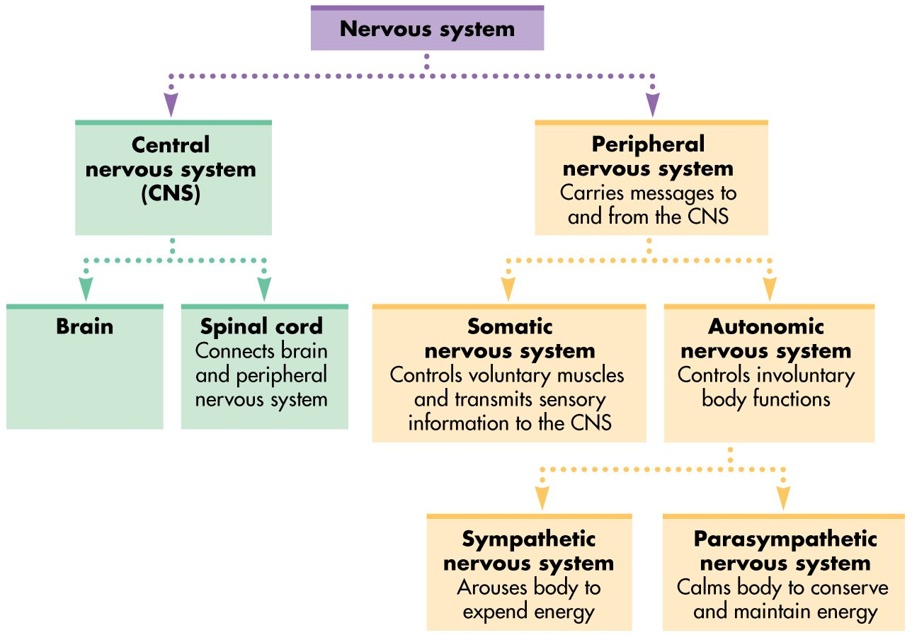
Pinrest.com https://www.pinterest.com.au/pin/217650594465085044/

Slide 7
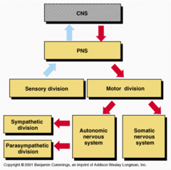

Slide 8
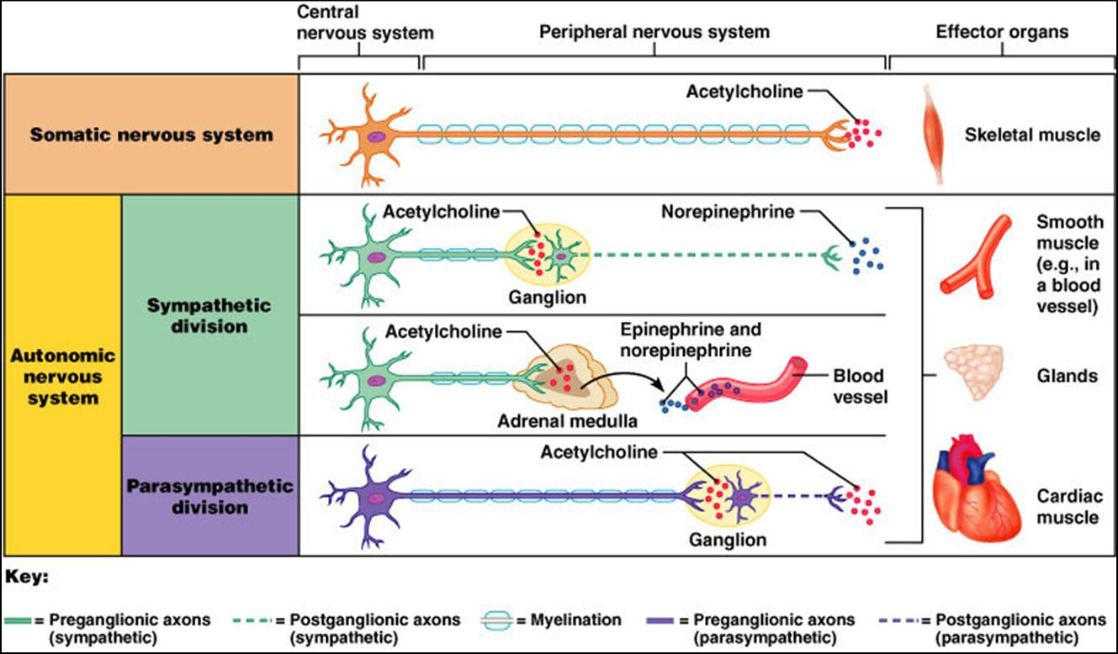
Neurotransmitters of the ANS
From: Pearson Education Inc.
Benjamin Cummings
(Neurotransmitters are degraded by COMT and MAO in the SNS and Acetylcholinesterase in the PNS)

Slide 9
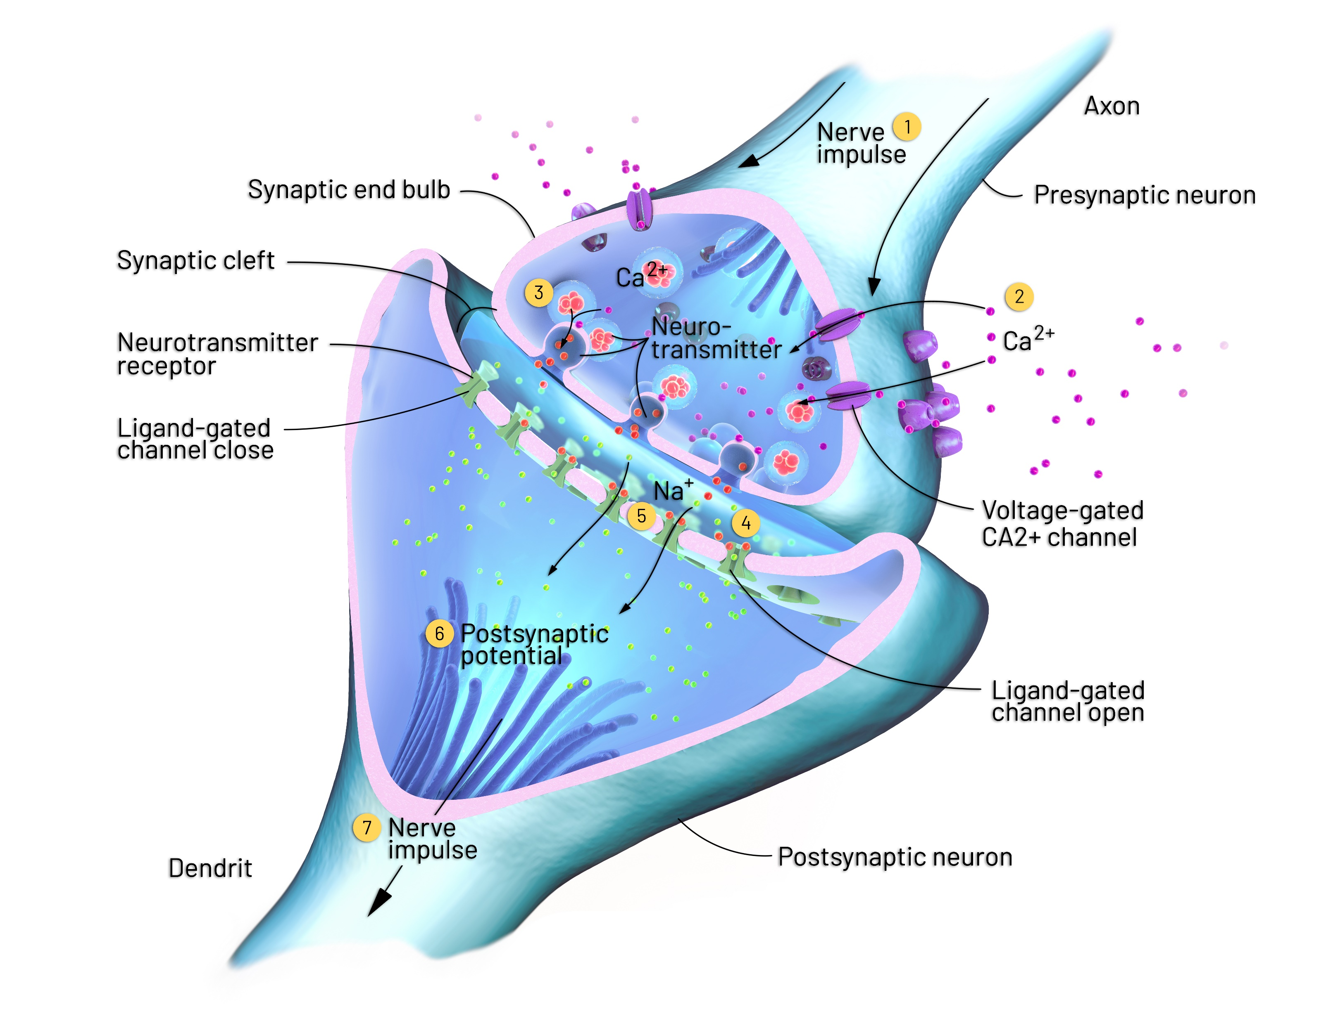

Slide 10
Autonomic Nervous System Pharmacology
Foundational Information for Understanding ANS Pharmacology
Lesson 2:
Using logic to understand the divisions of the ANS
Introductory Pharmacology PHAR2001
Dr Ken Wojcikowski

Slide 11
The sympathetic system
‘Fight or flight’ responses
  Rapid heart rate
  No need to digest or urinate
  Need to dilate pupils
Think about the last time
a bear chased you…

Slide 12

https://www.telegraph.co.uk/news/newstopics/howaboutthat

Slide 13
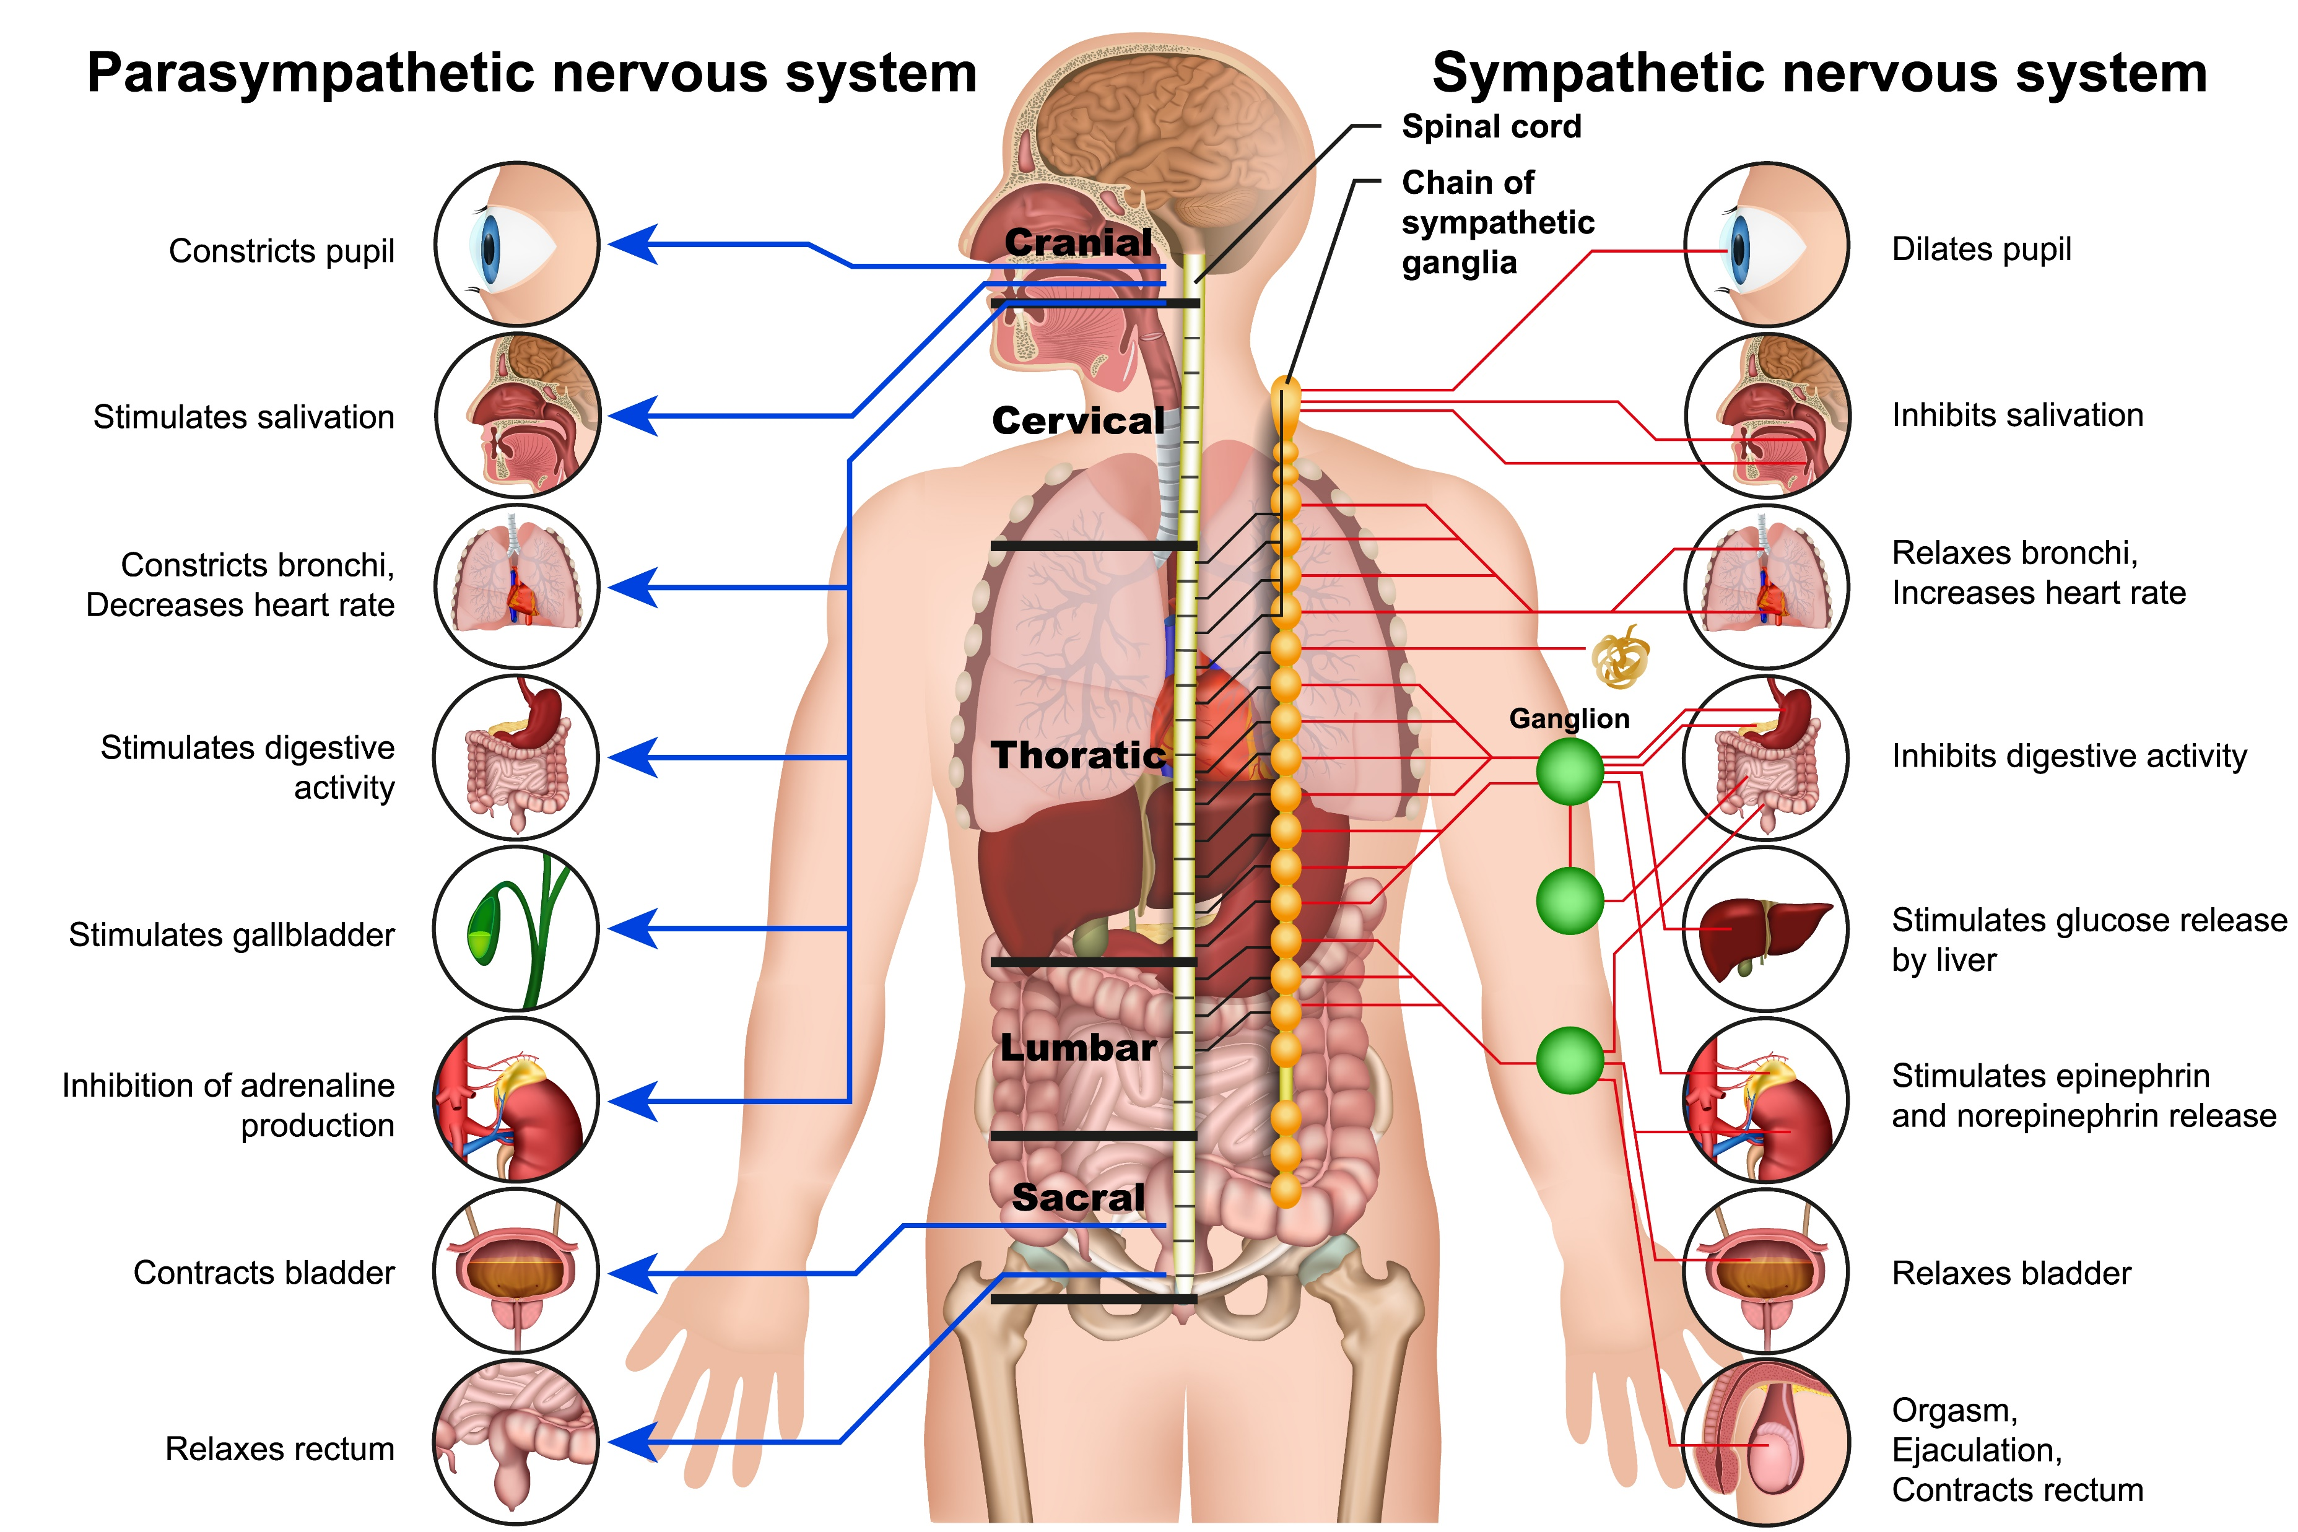
Relaxes urinary sphincters
Contracts urinary sphincters

Slide 14
The parasympathetic system
The ‘rest and digest’ system
  Heart rate slows
  Digestion begins
  Pupils constrict
Think about the last time you were able to chill out (well, try to remember)

Slide 15



Slide 16
Autonomic Nervous System Pharmacology
Foundational Information for Understanding ANS Pharmacology
Lesson 3:
Overview of the drugs of the ANS
Introductory Pharmacology PHAR2001
Dr Ken Wojcikowski

Slide 17
ANS pharmacology has one simple rule
Drugs that affect the autonomic nervous system have one of four actions
  They can increase the sympathetic system response
  They can increase the parasympathetic system response
  They can decrease the sympathetic system response
  They can decrease the parasympathetic system response

Slide 18
In medicine, there are always exceptions to the rule…
Drugs that affect the autonomic nervous system have one of four actions
  They can increase the sympathetic system response
  They can increase the parasympathetic system response
  They can decrease the sympathetic system response
  They can decrease the parasympathetic system response
EXCEPT:
  Alpha 2 receptors (sympathetic system)
  Central nicotinic receptors (parasympathetic system)
LET’S IGNORE THE EXCEPTIONS UNTIL LATER (postpone readings until the appropriate time)

Slide 19
Neurotransmitters of the ANS
From: Pearson Education Inc.
Benjamin Cummings
(Neurotransmitters are degraded by COMT and MAO in the SNS and Acetylcholinesterase in the PNS)

Slide 20
Relaxes urinary sphincters
Contracts urinary sphincters

Slide 21
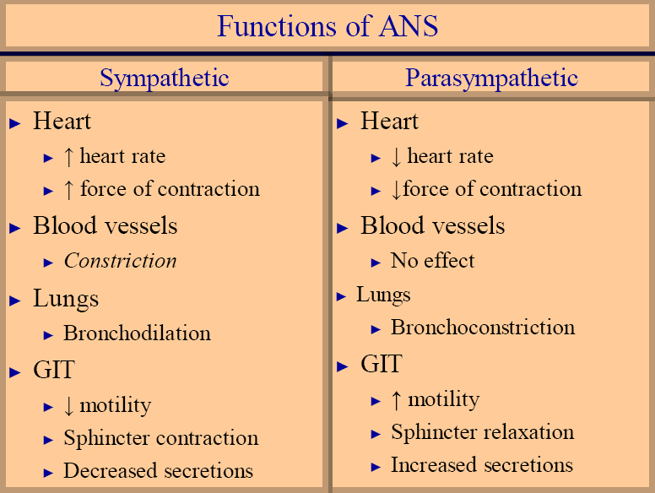

Slide 22

Autonomic Nervous System (ANS)
Sympathetic vs Parasympathetic

Slide 23
Autonomic Nervous System Pharmacology
Foundational Information for Understanding ANS Pharmacology
Lesson 4:
The selective nature of ANS receptors
Introductory Pharmacology PHAR2001
Dr Ken Wojcikowski

Slide 24
‘Selective’ SNS receptors: Alpha 1 receptors
Location of receptors:
  Blood vessels
  Smooth muscles of the GIT
  Sweat glands
  Radial muscles of the eye
  Sphincters of the bladder

Slide 25
‘Selective’ SNS receptors: Beta 1 receptors
Location of receptors:
  Heart
  Git
  Kidneys

Slide 26
‘Selective’ SNS receptors: Beta 2 receptors
Location of receptors:
  Lung
  Mast cells
  Uterus
  Skeletal muscle

Slide 27
References
Goldsy RA et Al. Immunology 5th ed. WH Freeman Publishers, 2003
Marieb E. Human Anatomy and Physiology, 5th ed. Benjamin Cummings, San Francisco, 2001
Rad, CC BY-SA 3.0 <http://creativecommons.org/licenses/by-sa/3.0/>, via Wikimedia Commons
Martini FH, et al. Visual Anatomy and Physiology 1st ed. Benjamin Cummings, 2011
Royalty free images from Shutterstock
The PowerPoint and associated Video were edited and produced by Dr. Ken Wojcikowski

